Slide 1
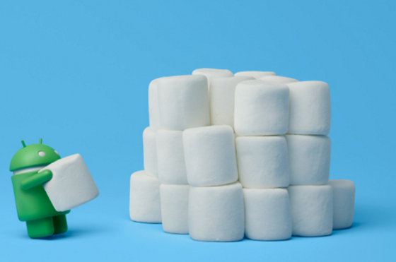
Build your Material Design app

Slide 2
Step 1：Let's see some popular apps on android platform
Step 2：Share some android developmer aspirations
Step 3：Introduce android support library widget and show it how to use in project
Step4: Some MD design style animation

Slide 3
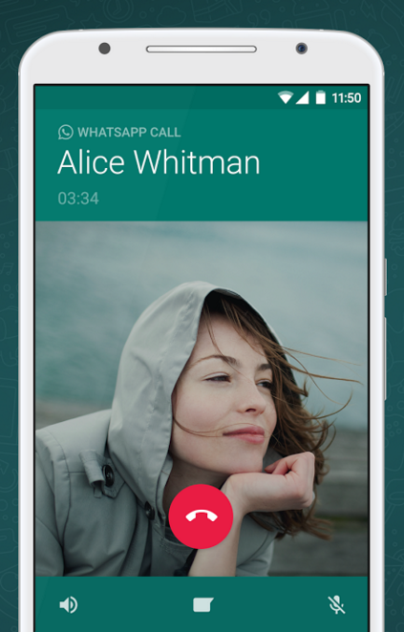
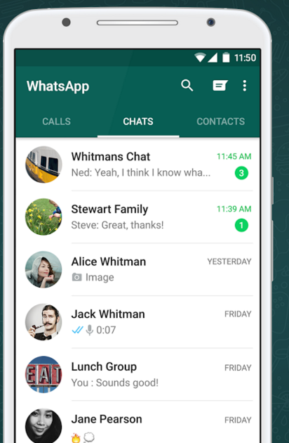
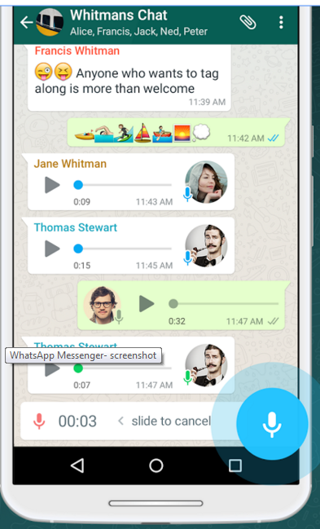
whatsapp

Slide 4
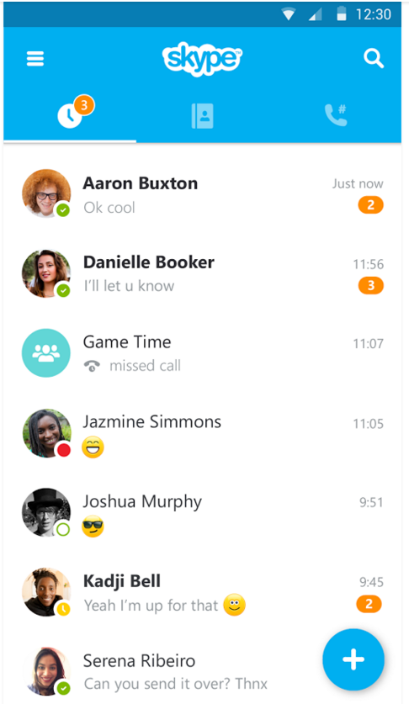
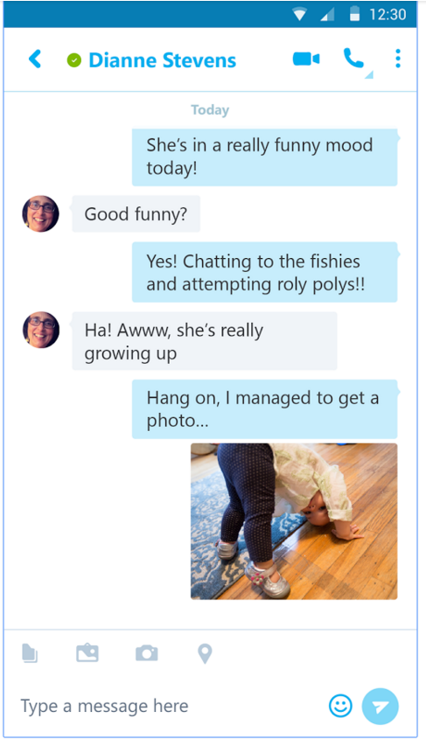
skype

Slide 5
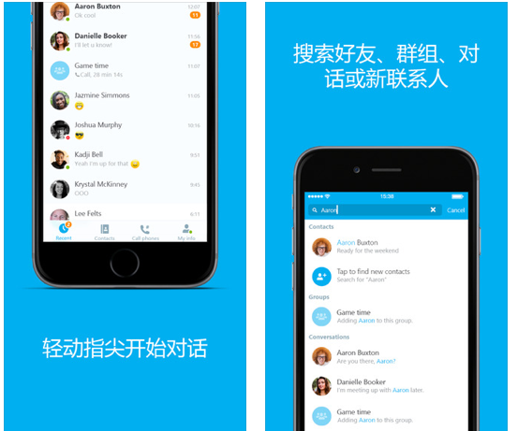

Slide 6
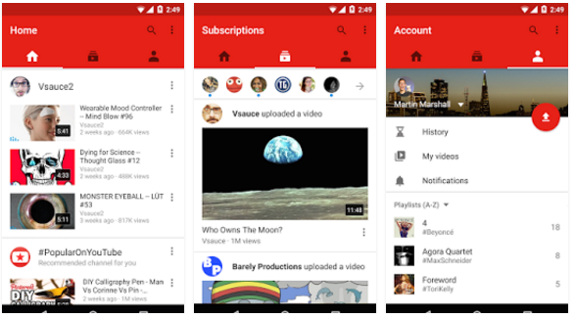
YouTube

Slide 7
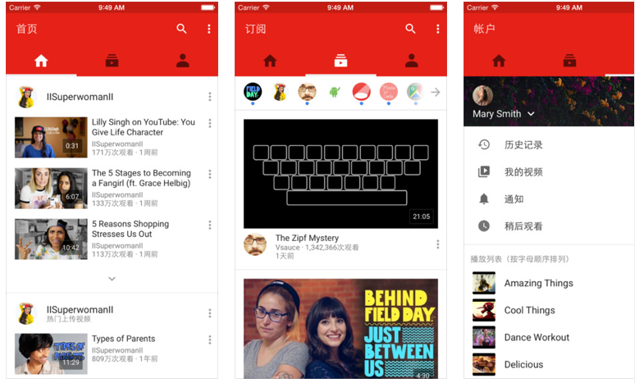
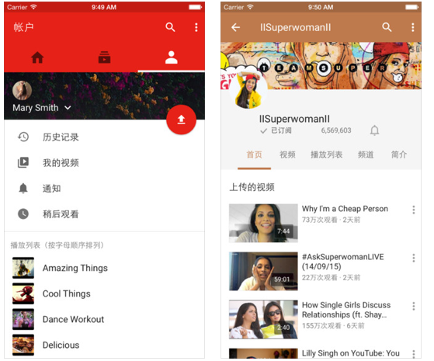

Slide 8
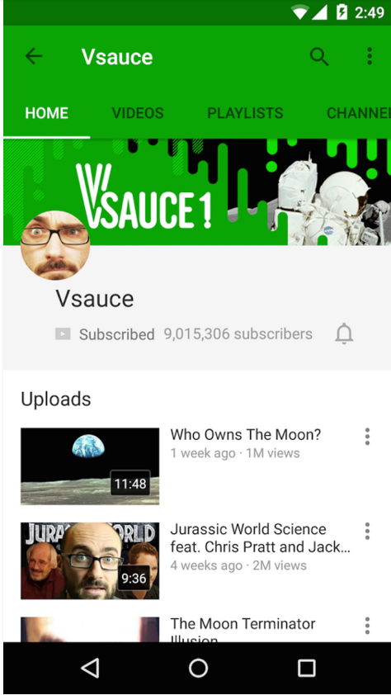
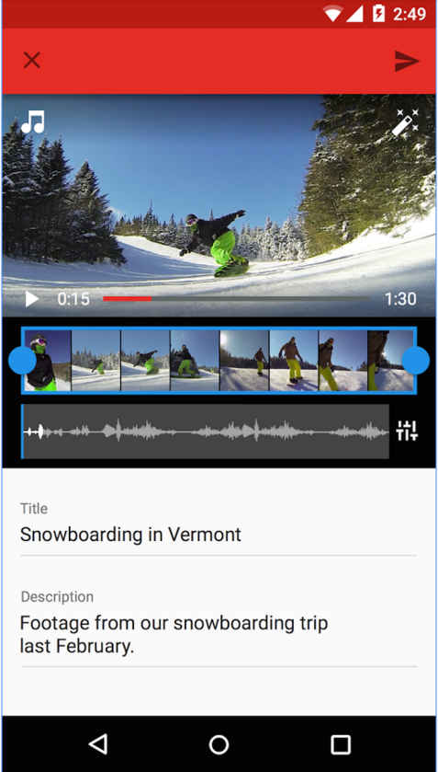

Slide 9
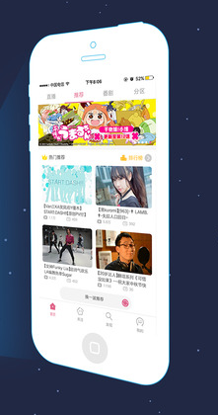
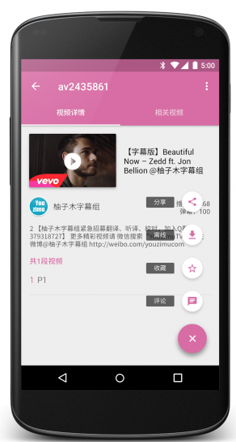
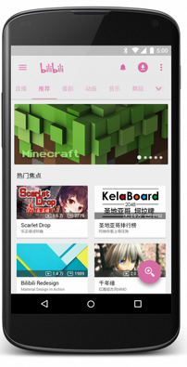
bilibili

Slide 10
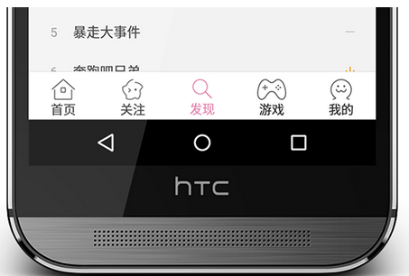

Slide 11
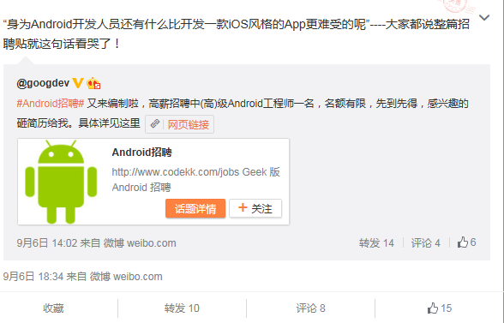

Slide 12
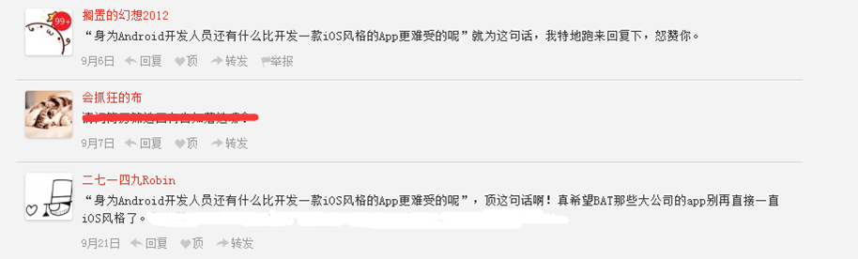

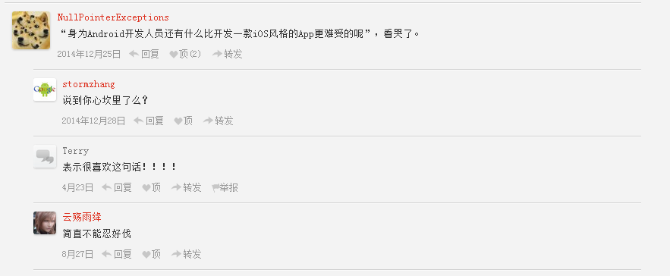
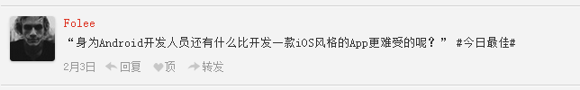

Slide 13
ToolBar - replace traditional ActionBar
1. app style must base on without actionbar
parent="Theme.AppCompat.Light.NoActionBar"
2. need to extend AppCompatActivity/ActionbarActivity
（AppCompatActivity extend ActionbarActivity，ActionbarActivity extend FragmentActivity）
3. setup your app Color Palette

Slide 14
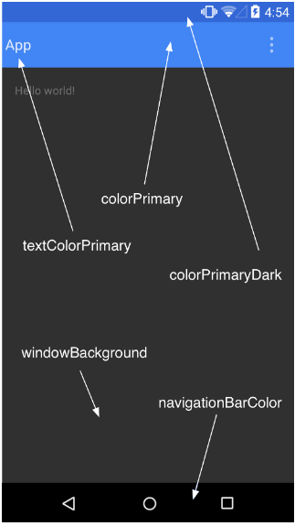
colorPrimary ：
toolbar color
colorPrimaryDark ：
statusbar color
colorAccent ：
toolbar text &RadioButton
&CheckBox color
（default value）
api21 5.0

Slide 15
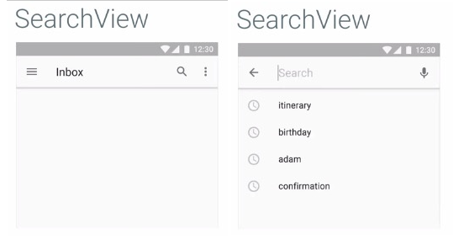

Slide 16

Palette: extract colors from a picture
（can make the UI style remain consistant）
Vibrant （有活力）
Vibrant dark（有活力 暗色）
Vibrant light（有活力 亮色）
Muted （柔和）
Muted dark（柔和 暗色）
Muted light（柔和 亮色）

Slide 17
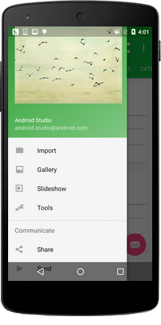
NavigationView
An Important view in
MD design library.
app:headerLayout
app:menu

Slide 18
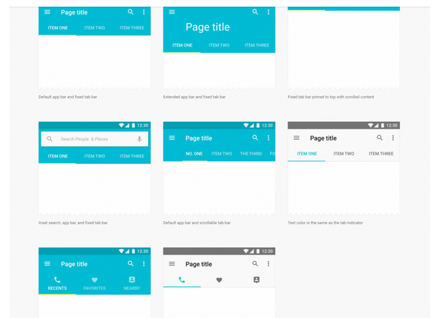
CoordinatorLayout & TabLayout & AppBarLayout

Slide 19
TextInputLayout

Slide 20
FloatingActionButton
default color is colorAccent(current theme)

Slide 21
Snackbar

Slide 22
CardView

Slide 23
SwipeRefreshLayout

Slide 24
CollapsingToolbarLayout

Slide 25
RecyclerView

Slide 26
Android L animation

